Slide 1
Physical and Logical
Design Layout
Andy Le
Kevin Duran Torres
Raymond Delgado

Slide 2
Ceiling Connection
Staff comp
W.G switch
W.G switch
W.G switch
Staff comp
switch
comp
comp
comp
comp
comp
comp
Print
comp
comp
comp
comp
comp
comp
40ft
Print
comp
comp
comp
comp
comp
comp
Computer Lab
40x30 feet
comp
comp
comp
comp
comp
comp
Door
comp
comp
comp
comp
comp
comp
30ft
Notes:
30 Computers
3 Workgroup switch
1 classroom switch
2 staff computers
2 printers
Each staff computer and printer will connect to the main computer lab switch.
Each workstation computer in a row will connect their ethernet cable to the work group switch in that row. The work group switch will then connect to the main computer lab switch, that will then lead to the ceiling.

Slide 3
Ceiling Connection
Door
Teacher’s computer
Teacher’s desk
Projector
Classroom Lecture
30x25 feet
Desk
Desk
Desk
Desk
Desk
30ft
Desk
Desk
Desk
Desk
Desk
Desk
Desk
Desk
Desk
Desk
Desk
Desk
Desk
Desk
Desk
Desk
Desk
Desk
Desk
Desk
20 ft
Notes:
6x Classroom Labs
1 Teacher computer
1 projector
The teacher’s computer’s ethernet cable will connect directly to the ceiling.

Slide 4
Door
Projector
Teacher’s computer
Printer
Lecture Lab
30x25 feet
switch
Student Table
comp
comp
30ft
Student Table
Ceiling Connection
comp
comp
Student Table
comp
comp
Student Table
comp
comp
Student Table
comp
comp
25 ft
Notes:
5x Lecture Lab
10 computers
1 work group switch
1 Teacher computer
1 projector
1 printer
The teacher’s computer will have the projector connected. The teacher’s computer will connect to the switch.
Each workgroup computer will connect to the switch. The printer will connect to the switch.
All via ethernet cable
The switch will lead up to the ceiling.

Slide 5
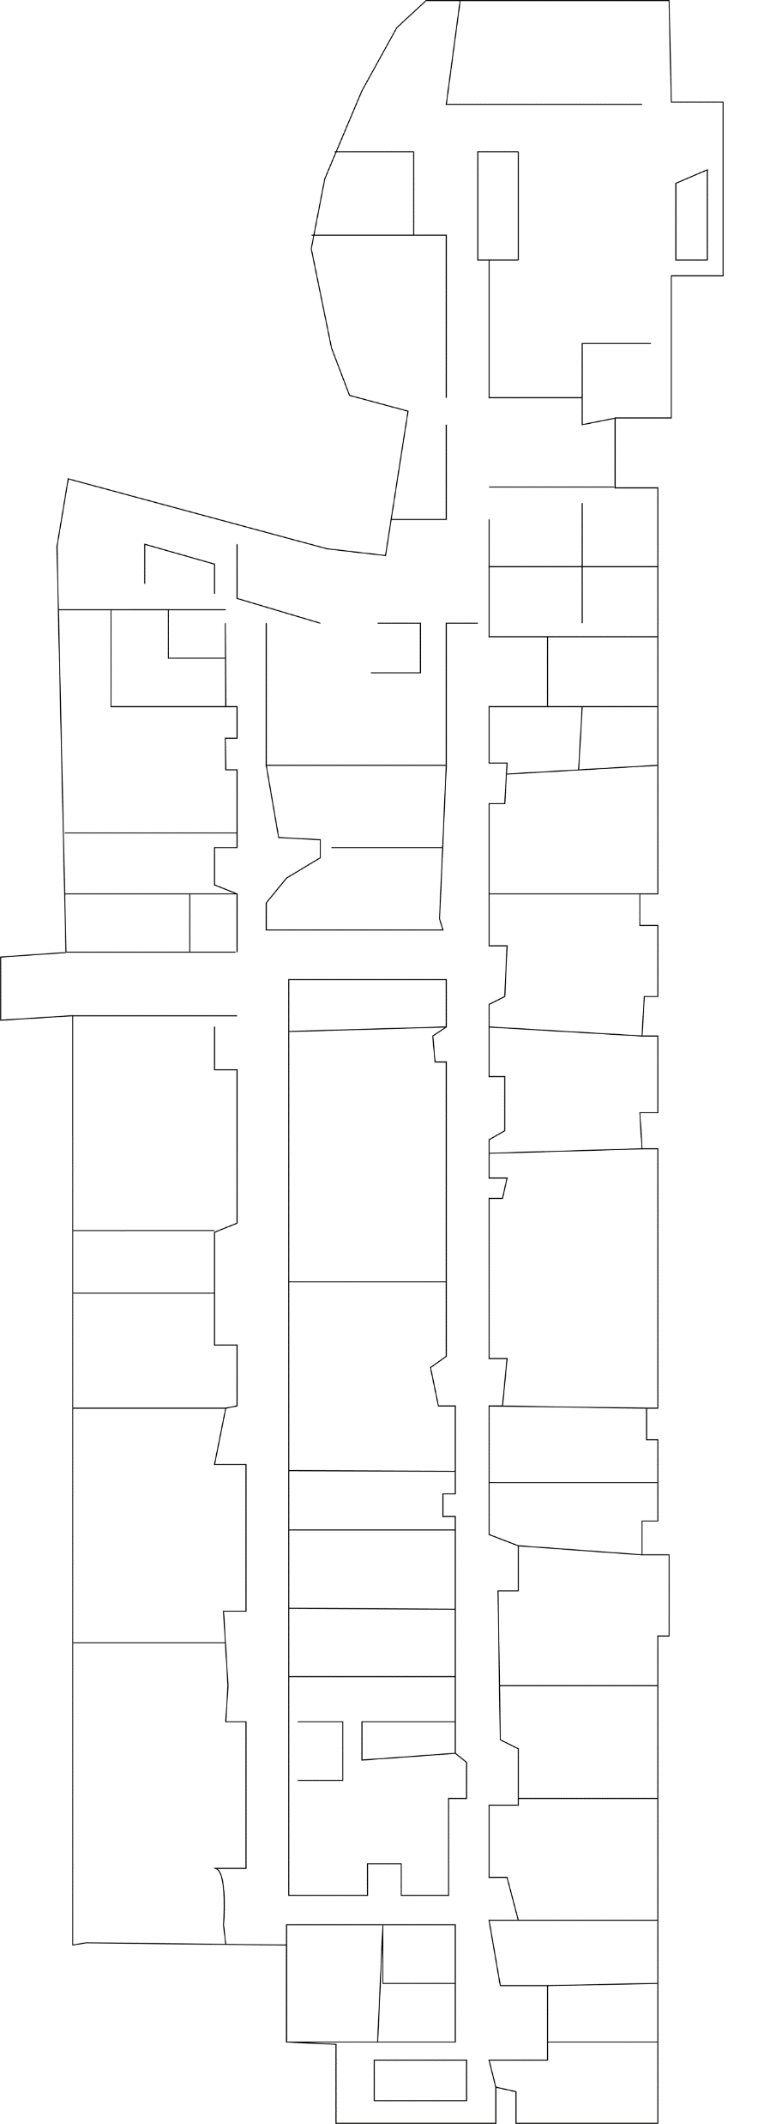
Floor Plan
205x95
Notes:
This is an estimated floor layout. 205x95 feet.

Slide 6
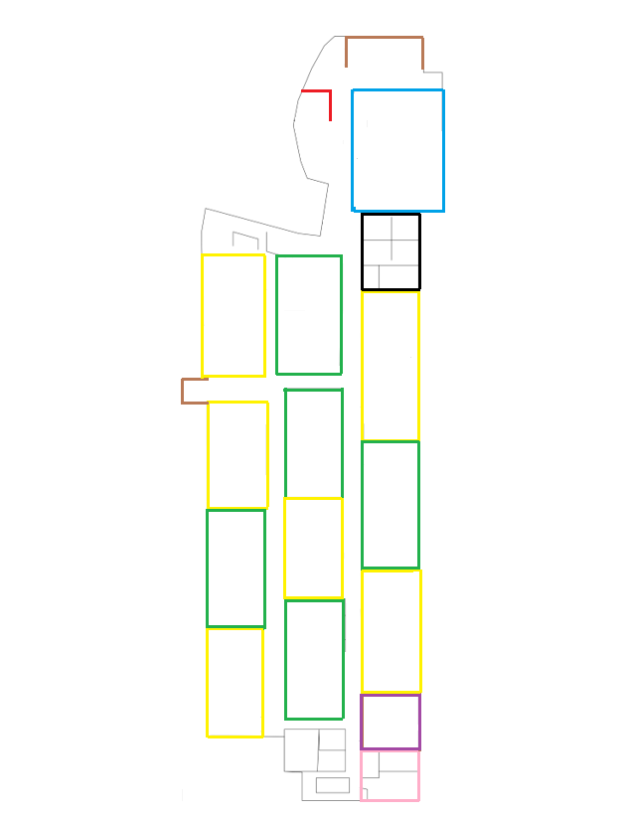
Legend
Computer Lab = Blue
Server Room = Black
Lecture Lab = Green
Classroom = Yellow
Purple = Men’s Restroom
Pink = Ladies’ Restroom
Brown = Stairs
Red = Elevator

Slide 7
Wireless Access Points
Notes:
2 wireless access points
1 server
The wireless access point has a radius of 45 meters in strength.

Slide 8
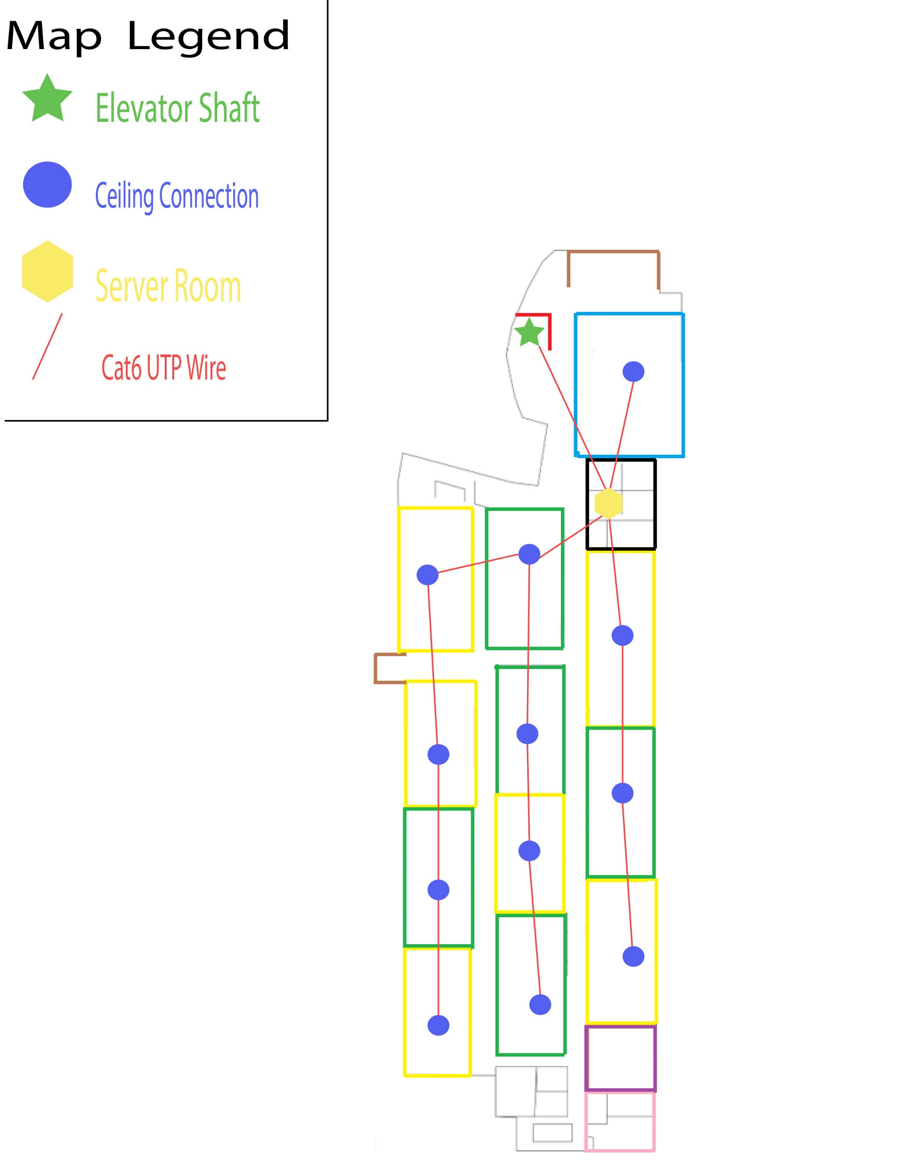
Ethernet Ceiling Layout
Notes:
This is a view of the floor through the ceiling.
Each room will have either an ethernet cable from the ceiling all heading towards the server room to connect to one main core switch. That core switch will have its own ethernet cable to go up the elevator shaft to a different floor to connect to the router.

Slide 9
Network Diagram
(whole network)

Slide 10
Internet
Server
Core
Switch
Switch
Classroom Devices
Science Lab Devices
Computer Lab Devices
Notes:
The logical design consists of three primary levels. The first level consist the devices that the students will use. Those devices will connect to switch , and the switch will connect to a core switch. The core switch will connect to the server room. The server room will connect to a router that is on the second level. The router will connect our network to the internet.

Slide 11
Network Diagram
(Class Room)

Slide 12
Internet
Server
Core Switch
Teacher’s Computer
Projector
Notes:
See slide ten for details about the logical design.

Slide 13
Network Diagram
(Science Lab)

Slide 14
Internet
Server
Core Switch
Switch
Printer
Computer 6x
Teacher’s Computer
Projector
Notes:
See slide ten for details about the logical design.

Slide 15
Network Diagram
(Computer Lab)

Slide 16
Internet
Server
Core Switch
Switch
W.G Switch 3x
Computer 30x
Printer 2x
Staff’s Computer
2x
Notes:
See slide ten for details about the logical design.

